Slide 1




Router Design
By: Kumar Sai Reddy Guntaka
Instructor: Orod Haghighiara
Date: 12/05/2022

Slide 2

Introduction:
Routing is the act of transporting a data packet from its origin to its destination, allowing messages to move from one computer to another and finally reach the destination system. A router is a networking device that transmits data packets from one computer network to another. It is linked to two or more data lines from several networks (as opposed to a network switch, which connects data lines from one single network).

Slide 3

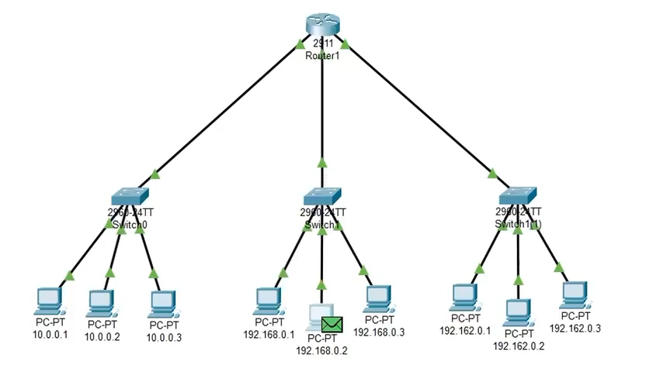
Cisco Packet Tracer

Slide 4
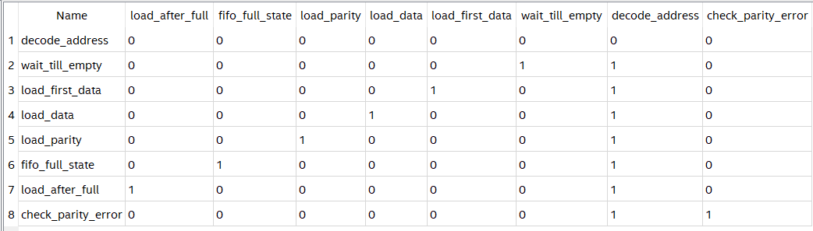
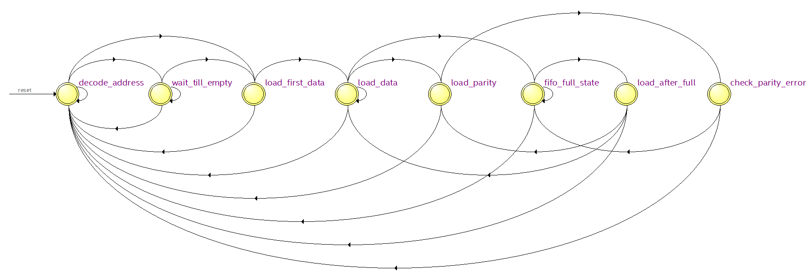
FSM:

Slide 5

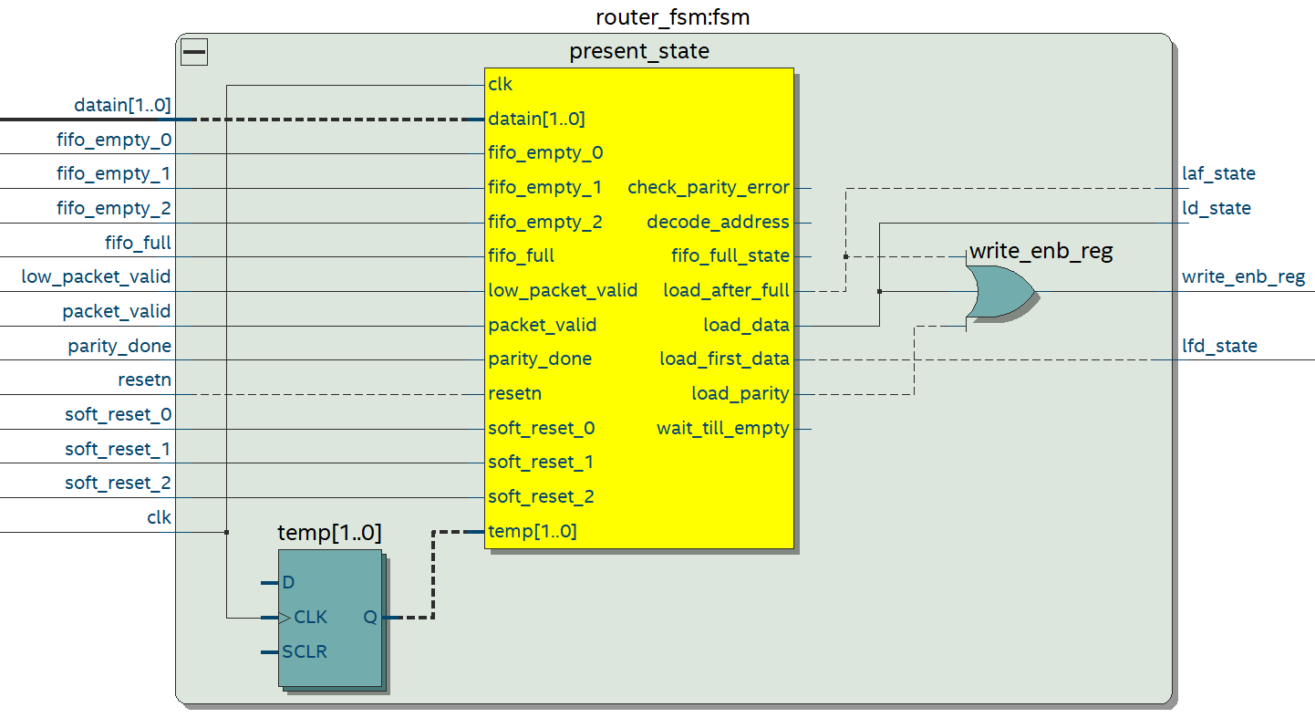
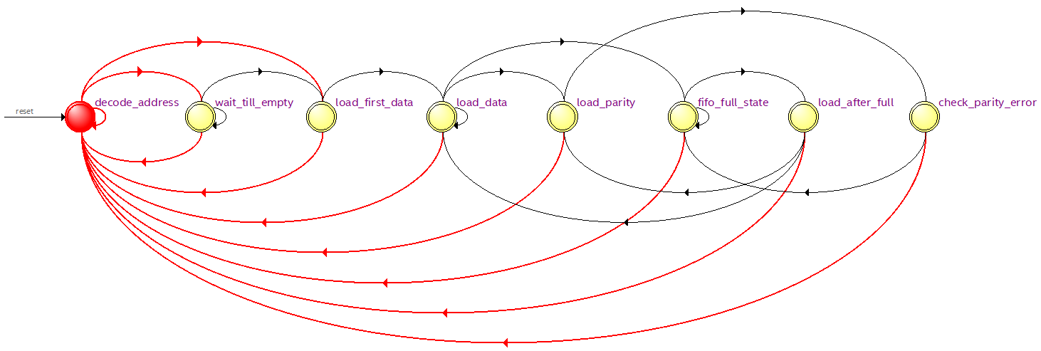

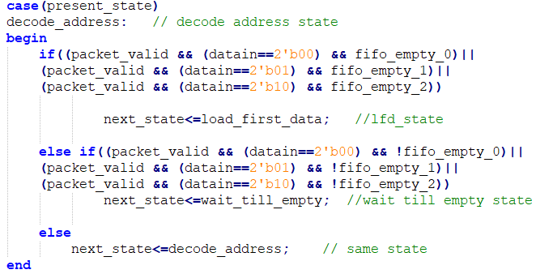
State1: Decode address
FSM is the monitoring and controlling unit of the router architecture.
State1: Decode_Address -> initial reset state
Signal detect_add is asserted in this state which is used to detect an incoming packet. It is also used to latch the first byte as a header byte.

Slide 6
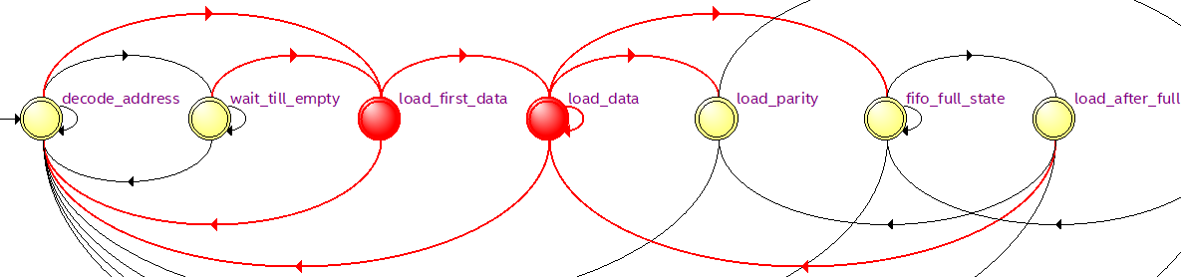
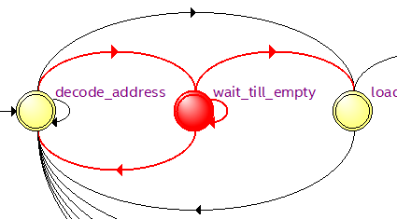
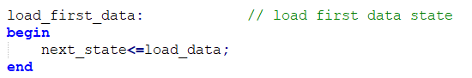
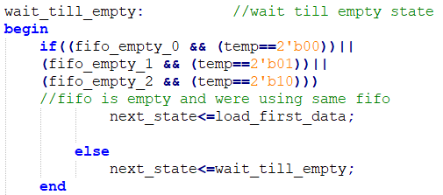
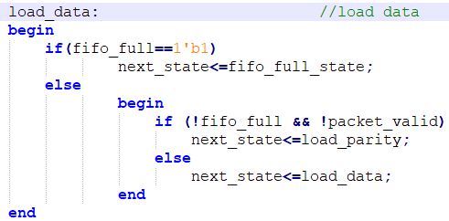
State 3: Load_data and first data
State2: Wait_till_empty
The first data byte to the FIFO. Signal busy is also asserted in this state so that header byte that is already latched doesn’t update to a new value for the current packet.
This state is changed to LAOD_DATA state unconditionally in the next clock cycle.
Signal busy is de asserted in this state, so that ROUTER can receive the new data from input source every clock cycle,
Signal write_enb_reg is asserted in this state in order to write the Packet information (Header+Payload+Parity) to the selected FIFO.
This state transits to LAOD_PARITY state when pkt_valid goes low and to FIFO_FULL_STATE when FIFO is full.

Slide 7
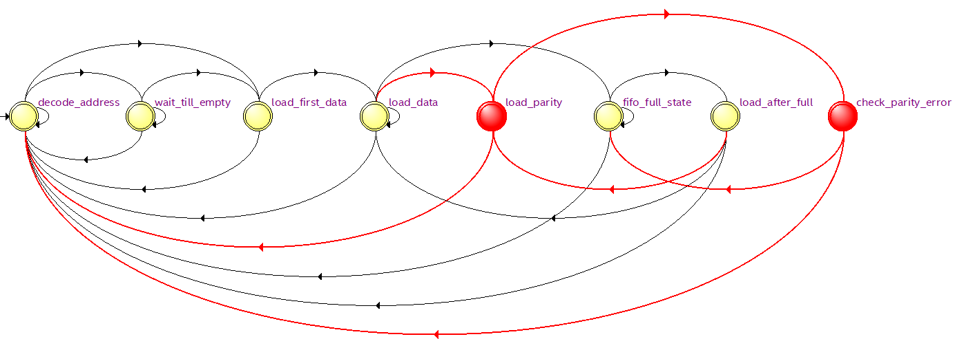
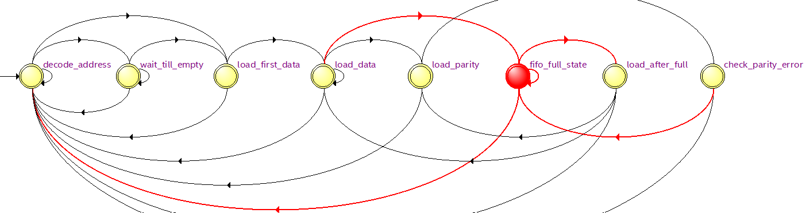
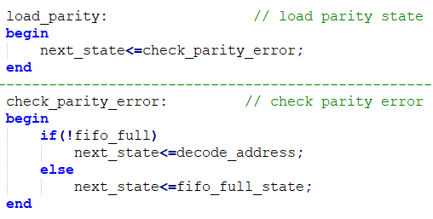
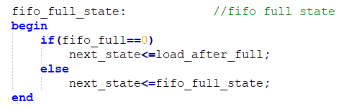
State4&8: Load parity, check parity error
State5: FIFO full state
In this state the last byte is latched which is the parity byte. It goes unconditionally to the state CHECK_PARITY_ERROR.
Signal busy is asserted so that ROUTER doesn‟t accepts any new data. write_enb_reg is made high for latching the parity byte to FIFO.
Busy signal is made high and write_enb_reg signal is made low.
Signal full_state is asserted which detects the FIFO full state.

Slide 8
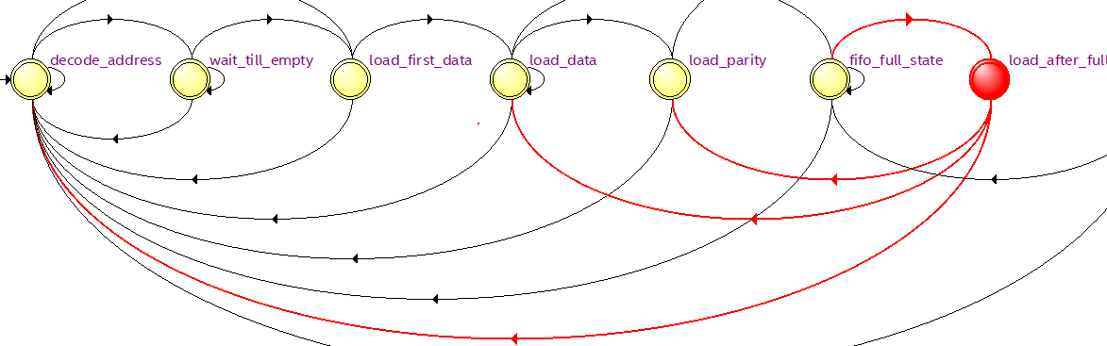
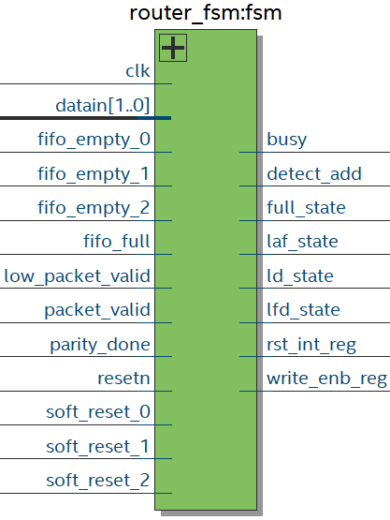
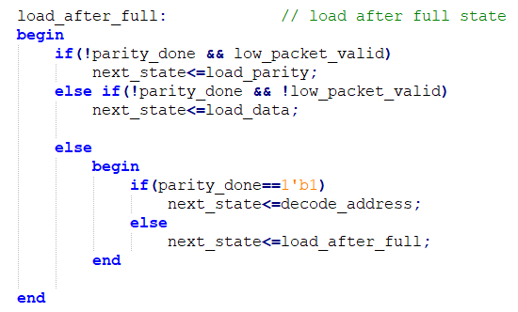
Load after full state:
The data after FIFO_FULL_STATE. Signal busy & write_enb_reg is asserted. It checks for parity_done signal and if it is high, shows that LOAD_PARITY state has been detected and it goes to the state DECODE_ADDRESS.
If low_packet_valid is high it goes to LOAD_PARITY state otherwise it goes back to the LOAD_DATA state.

Slide 9
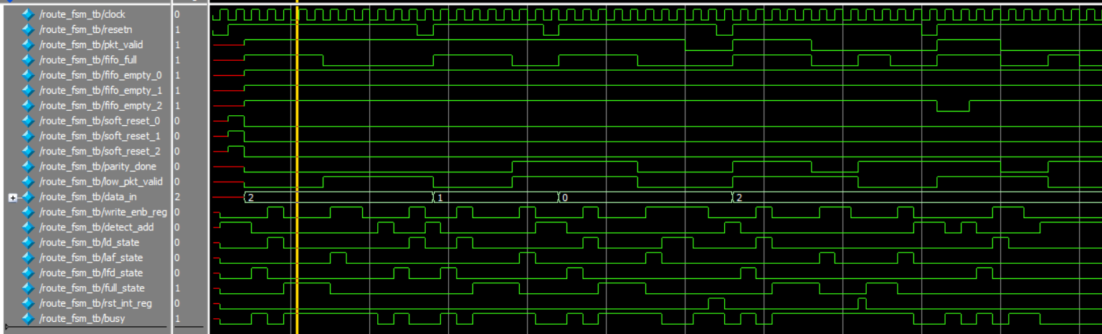
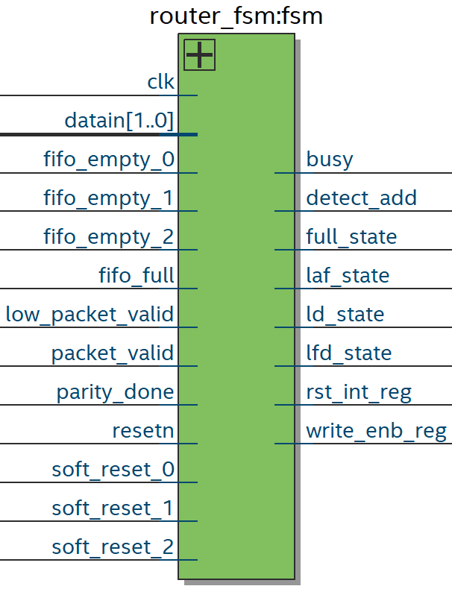
FSM

Slide 10
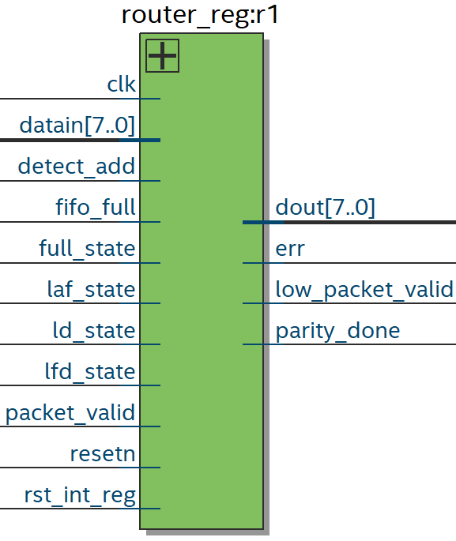
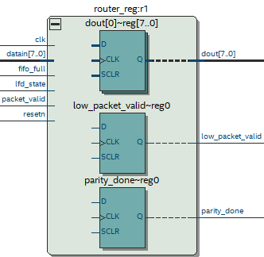
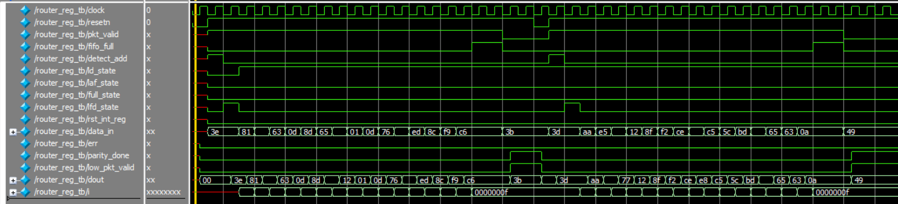
REGISTER

Slide 11
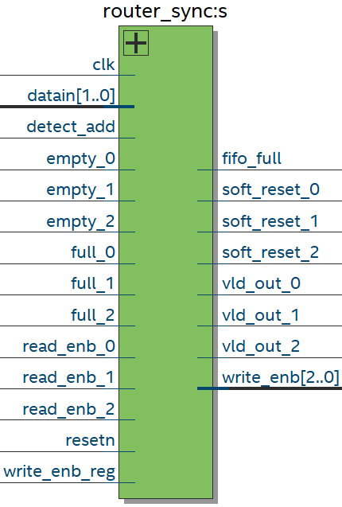
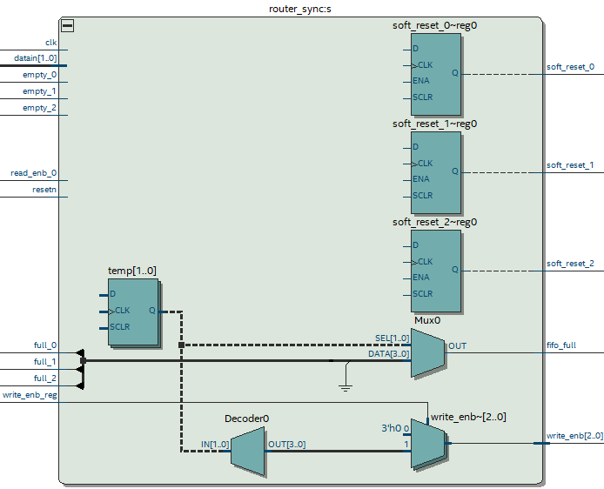
SYNCHRONIZER
Detect_add and data_in signals are used to select a FIFO till a packet routing is over for the selected FIFO.
Signal fifo_full signal is asserted based on full_status of fifo_0 or FIFO_1 or FIFO_2.
If data_in =2‟b00 then fifo_full=full_0
If data_in=2‟b01 then fifo_full=full_1
If data_in=2‟b10 then fifo_full=full_2 else fifo_full=0
The signal vld_out_x signal is generated based on empty status of the FIFO as shown below :
vld_out_0=~empty_0
vld_out_1=~empty_1
vld_out_2=~empty_2
The write_enb_reg signal is used to generate write_enb signal for the write operation of the selected FIFO.

Slide 12

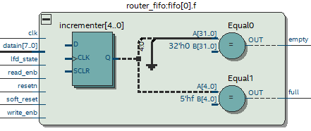
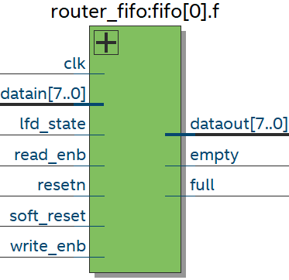
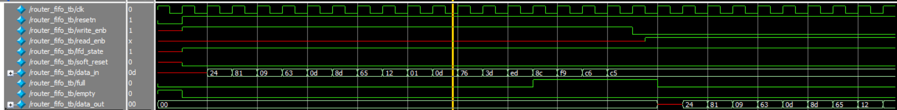
FIFO Block:
The FIFO works on the system clock and is reset
with a synchronizer active low reset.The FIFO is also internally reset by an internal reset signal soft_reset. Soft_reset is an active high signal which is generated by the SYNCHRONIZER block during time out state of the ROUTER. If resetn is low then full=0, empty=1 and data_out=0.
Write_Operation: Signal data_in is sampled at the rising edge of the edge of the clock when write_enb is high. Write operation only takes place when FIFO is not full in order to avoid over_run condition.
Read_Operation: Data out is driven to HIGH impedance state under 2 scenarios: When the fifo m/m is read completely (header+payload+parity).
Under the time out condition of the Router. Full- FIFO status which indicates that all the locations inside FIFO have been written. Empty- FIFO status which indicates that all the locations of the FIFO have been read and made empty. Read and write operation can be done simultaneously.

Slide 13
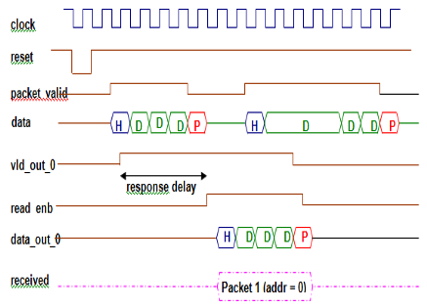
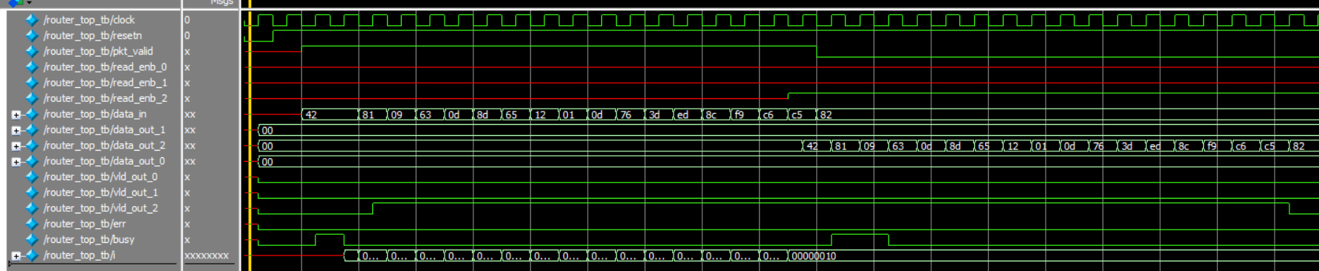
Top Module Output Protocol:

Slide 14
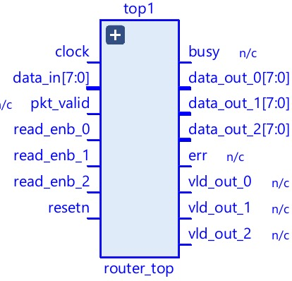
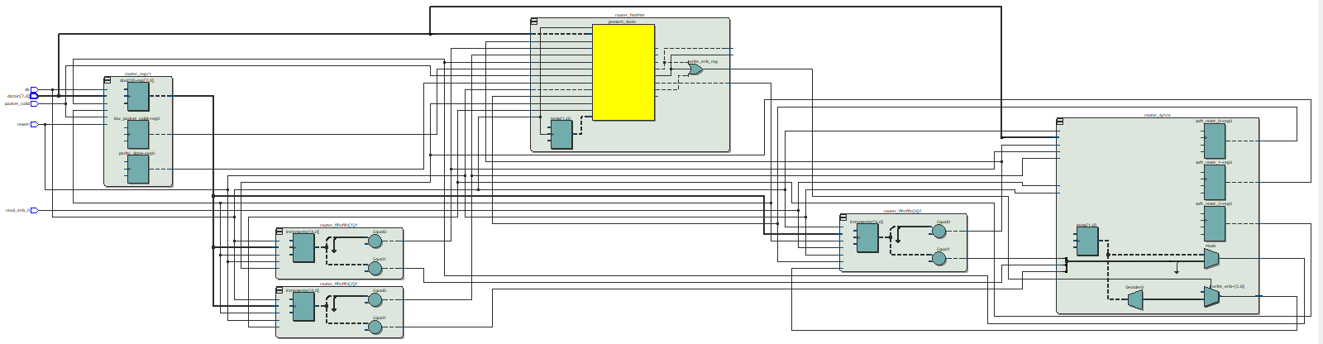
Top Module

Slide 15
References
[1] Priyanka Rakshe and Pankaj Prajapati," "Router1x3 Protocol design with Virtual cut through Mechanism for Network on Chip (NoC)", Journal of Emerging Technologies and Innovative Research
[2] Ramya. C.B, Chethan. C.M, Praveen. S.G, Rakshith S, "Design and Implementation of Spartan 6 Series FPGA Board and Application of PID Controller for Robots", International Journal of Recent Advances in Engineering & Technology (IJRAET) Volume-3, Issue -5, 2015\
[3] Router 1X3 – RTL Design
[4] https://www.khanacademy.org/computing/computers-and-internet
[5] Neso Academy: https://www.youtube.com/watch?v=xwaqSZHK8eM

Slide 16

Thank you

